Slide 1
Tutorial 8
Statistical Computation and Analysis
Spring 2026

Slide 2
Assignment 2 quiz
15 minutes
Answer 4 out of 8 questions right to pass

Slide 3
Tutorial Outline
Continuous predictors & categorical predictors in regression
Simple linear regression
Multiple linear regression
Interaction model
Bayesian effect sizes:
Bayesian R²
Bayesian term-level partial R²
Bayesian η²
Bayesian Cohen’s f
Frequentist effect sizes:
R²
Term-level partial R²
η²
Cohen’s f

Slide 4
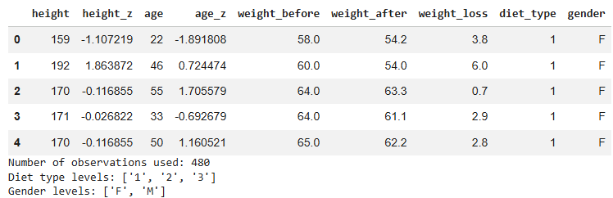
Data
Dataset - foodDiet_extended.csv
Notes:
Remainder – this is a “fake” dataset, not real data

Slide 5

Dataset and Variables
Dataset - foodDiet_extended.csv
Dependent variable
$$weight_loss_{i} ​=weight_before_{i} ​−weight_after_{i} ​$$
Predictors\ Independent variables:
Variable | Type | Transformation
age_z | continuous | standardized age
height_z | continuous | standardized height
diet_type | categorical | Coded as diet group :1, 2, 3
gender | categorical | coded as F / M
Notes:
Remainder – this is a “fake” dataset, not real data

Slide 6
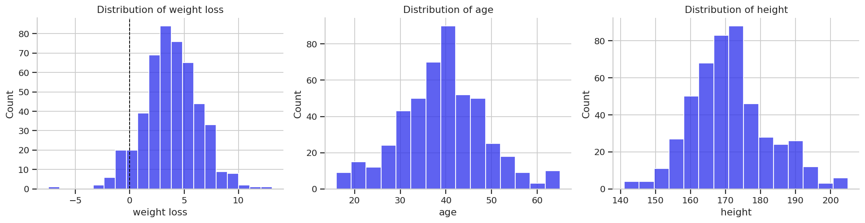

Data
Our dependent variable:
$$weight_loss_{i}=weight_{before_{i}}−weigh{t_{after}}_{i} ​$$

Slide 7
Data
Possible continuous independent variables:

Slide 8
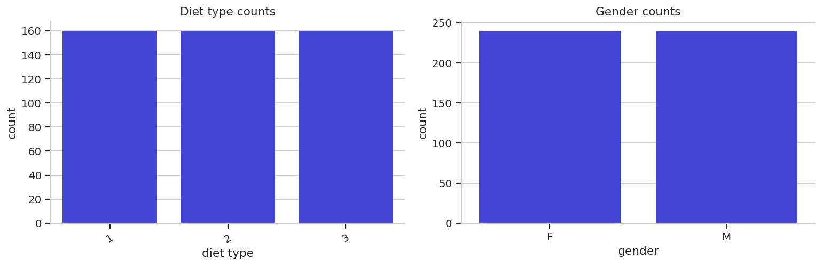
Data
Possible categorical independent variables:
Notes:
Remainder – this is a “fake” dataset, not real data

Slide 9
Today’s Models
Model Type |  | Wilkinson Notation
Simple linear | one continuous predictor | weight_loss ~ age_z
 | one categorical predictor | weight_loss ~ diet_type
Multiple linear | continuous + continuous predictors | weight_loss ~ age_z + height_z
 | categorical + categorical predictors | weight_loss ~ diet_type + gender
 | continuous + categorical predictors | weight_loss ~ age_z + diet_type
Interaction | continuous * categorical | weight_loss ~ age_z * diet_type
 | categorical * categorical | weight_loss ~ diet_type * gender
Notes:
Green - Simple linear regression
Blue - Multiple linear regression
Purple - Multiple linear regression with interaction
$$weight_loss \sim diet_type ∗ gender$$
Is the same as in Bambi
$$weight_loss \sim diet_type + gender + diet_type:gender$$

Slide 10
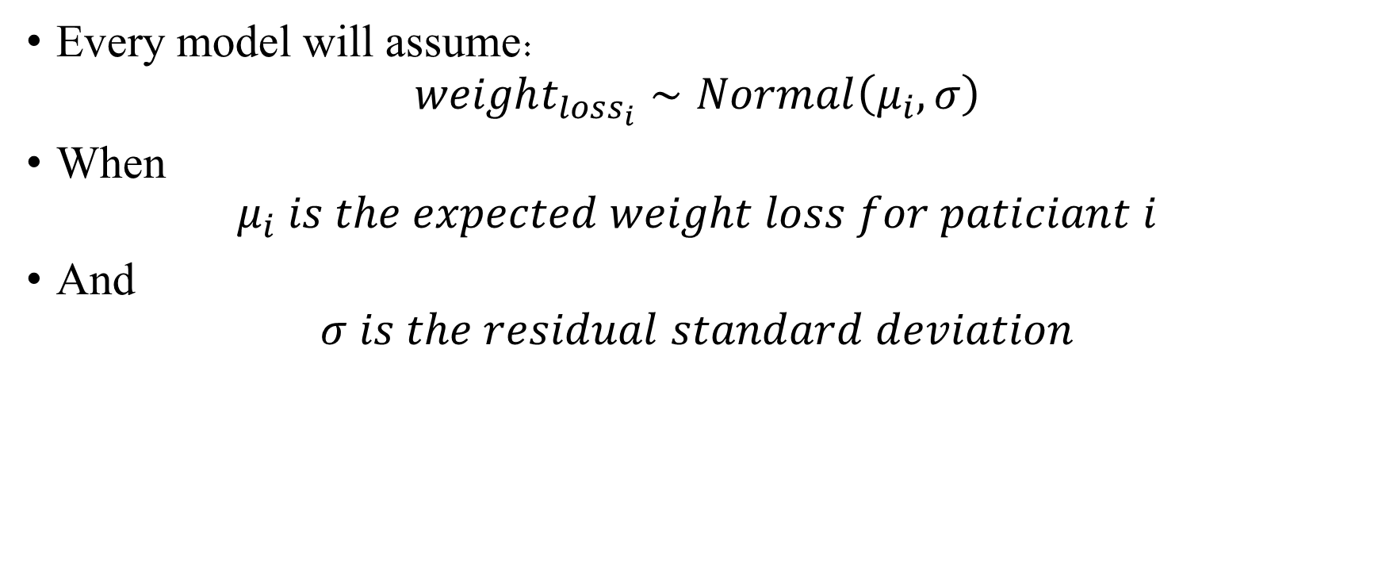
Bayesian Regression
Every model will assume:
$$weight_{loss_{i}​}∼Normal\left(μ_{i}​,σ\right)$$
When
$$μ_{i} is the expected weight loss for paticiant i$$
And
$$σ is the residual standard deviation$$

Slide 11
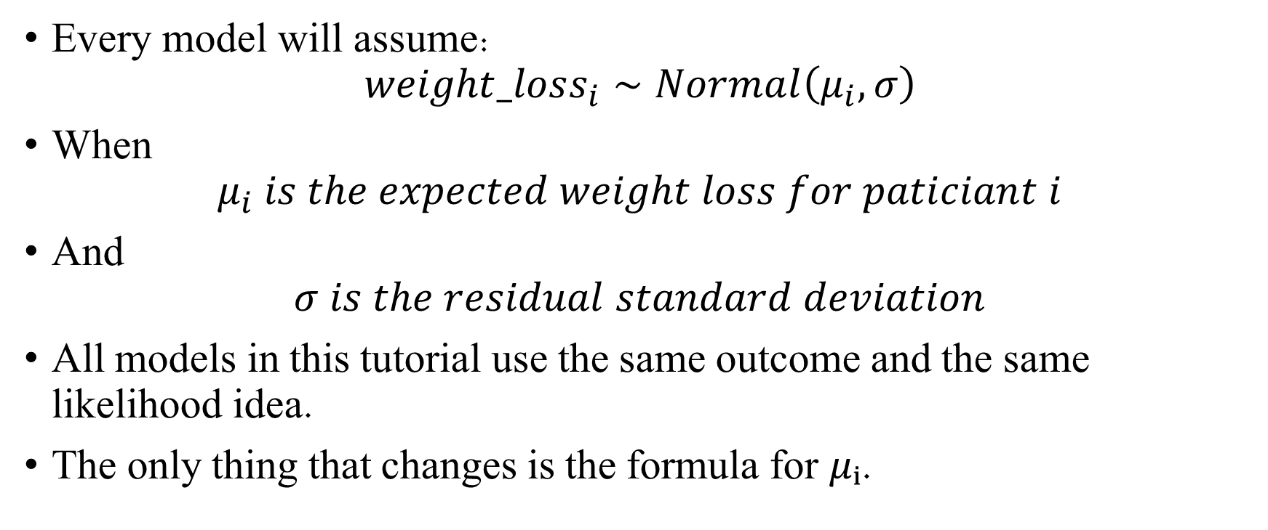
Bayesian Regression
Every model will assume:
$$weight_loss_{i}∼Normal\left(μ_{i}​,σ\right)$$
When
$$μ_{i} is the expected weight loss for paticiant i$$
And
$$σ is the residual standard deviation$$
All models in this tutorial use the same outcome and the same likelihood idea.
The only thing that changes is the formula for $μᵢ$.

Slide 12
Bayesian Regression
The full Bayseian workflow was also done for all models (and is expected of you).
See the tutorial code notebook for the full model code & outputs.

Slide 13
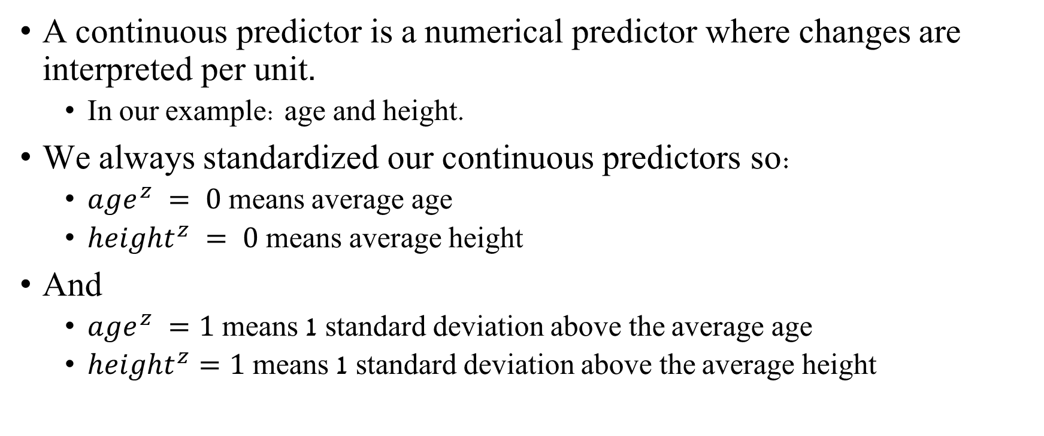
Continuous predictors in the regression model
A continuous predictor is a numerical predictor where changes are interpreted per unit.
In our example: age and height.
We always standardized our continuous predictors so:
$age^{z} = 0$ means average age
$height^{z} = 0$means average height
And
$age^{z} =1$ means 1 standard deviation above the average age
$height^{z}=1$ means 1 standard deviation above the average height
Notes:
Reminder

Slide 14
Categorical predictors in the regression model
A categorical predictor is a predictor whose values are labels, not numerical measurements.
In our example: diet_type and gender.
Categorical predictors cannot enter a regression model directly as text labels. They are represented using indicator variables.

Slide 15
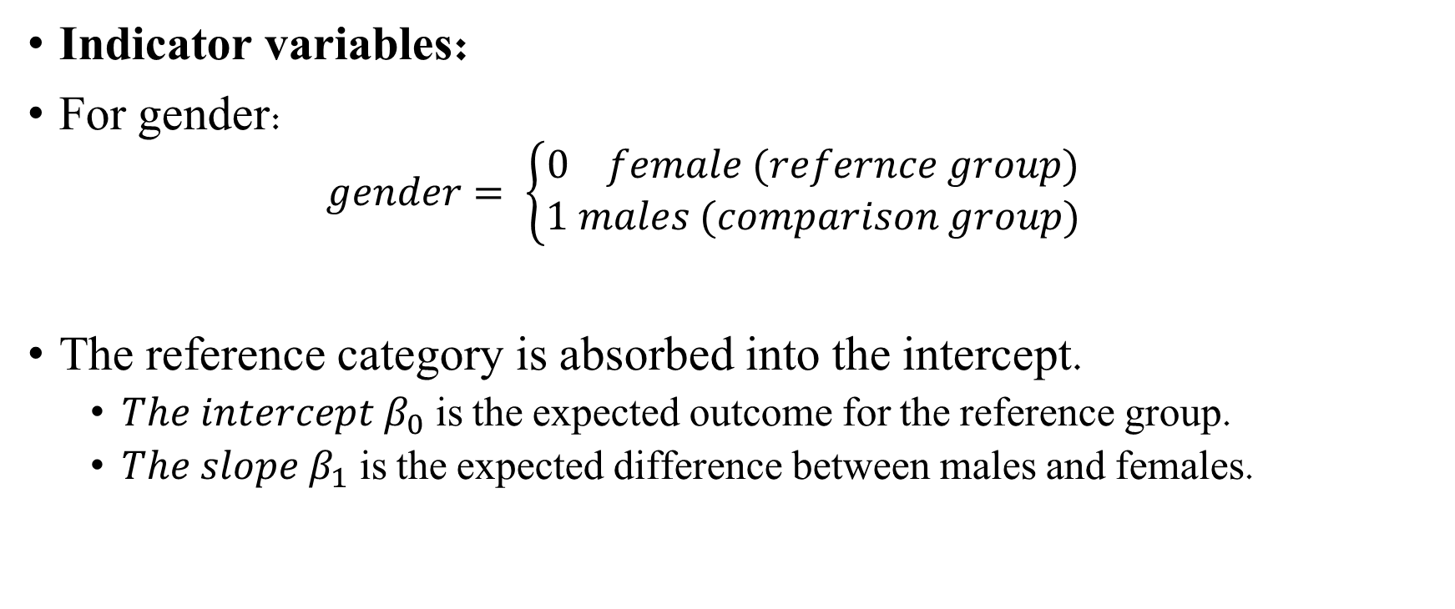
Categorical predictors in the regression model
Indicator variables:
For gender:
$$gender= \left\{\begin{aligned}0 female (refernce group) \\ 1 males (comparison group)\end{aligned}\right.$$
The reference category is absorbed into the intercept.
$The intercept β_{0}$ is the expected outcome for the reference group.
${The slope β}_{1}$ is the expected difference between males and females.
Notes:
For simple linear regression with one categorical predictor - $μ_{i}= β_{0}+ β_{1}x_{1}$

Slide 16
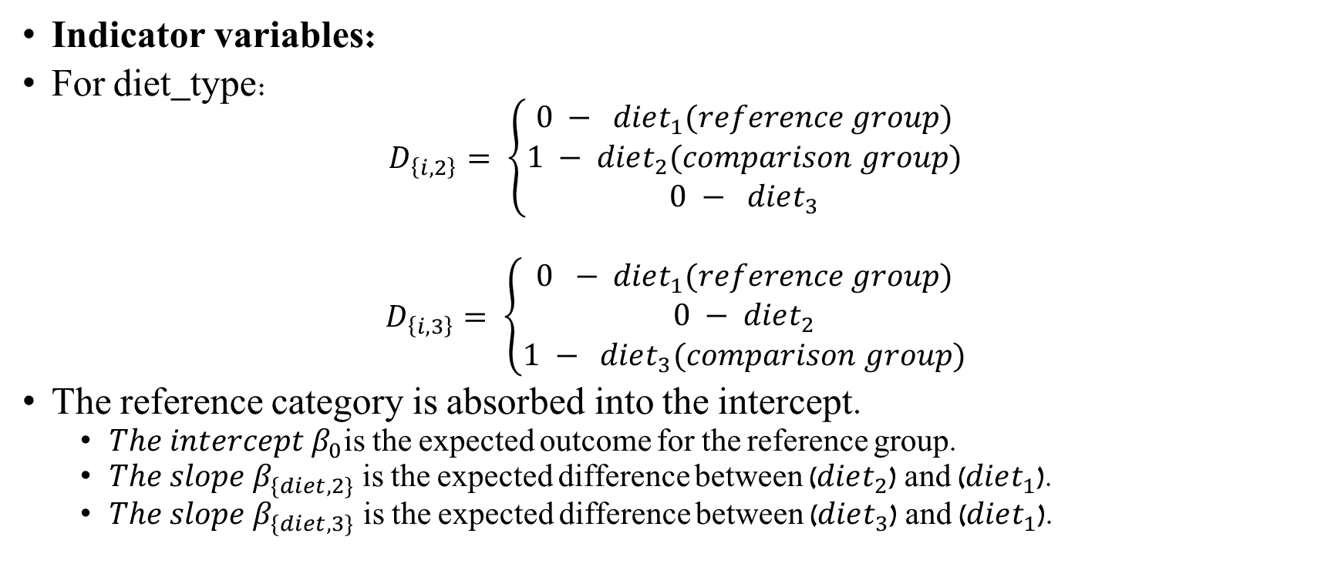
Categorical predictors in the regression model
Indicator variables:
For diet_type:
$$D_{\left\{i,2\right\}}= \left\{\begin{aligned}0 − diet_{1}(reference group) \\ 1 − diet_{2}(comparison group) \\ 0 − diet_{3}\end{aligned}\right.$$
$$D_{\left\{i,3\right\}}= \left\{\begin{aligned}0 − diet_{1}(reference group) \\ 0 − diet_{2} \\ 1 − diet_{3}(comparison group)\end{aligned}\right.$$
The reference category is absorbed into the intercept.
${The intercept β}_{0}$is the expected outcome for the reference group.
$The slope β_{\{diet,2\}}$ is the expected difference between ($diet_{2}$) and ($diet_{1}$).
${The slope β}_{\{diet,3\}}$is the expected difference between ($diet_{3}$) and ($diet_{1}$).
Notes:
For simple linear regression with one categorical predictor $μ_{i}= β_{0}+ β_{1}x_{1}+ β_{2}x_{2}$

Slide 17
Simple Linear Regression

Slide 18
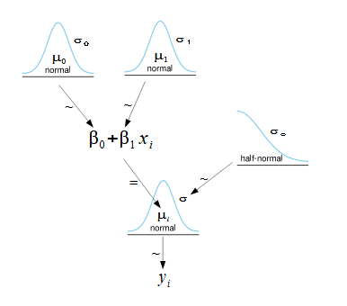
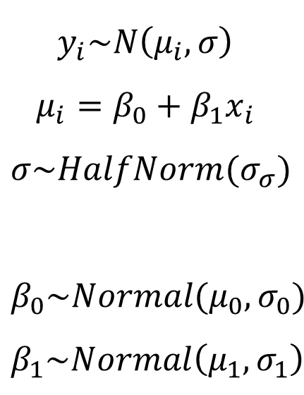
Simple Linear Regression
Bayesian model
$$y_{i}\sim N\left(μ_{i}, σ\right)$$
$$μ_{i}=β_{0}+β_{1}x_{i}$$
$$σ\sim HalfNorm(σ_{σ})$$
$$β_{0}\sim Normal(μ_{0},σ_{0})$$
$$β_{1}\sim Normal\left(μ_{1}, σ_{1}\right)$$

Slide 19
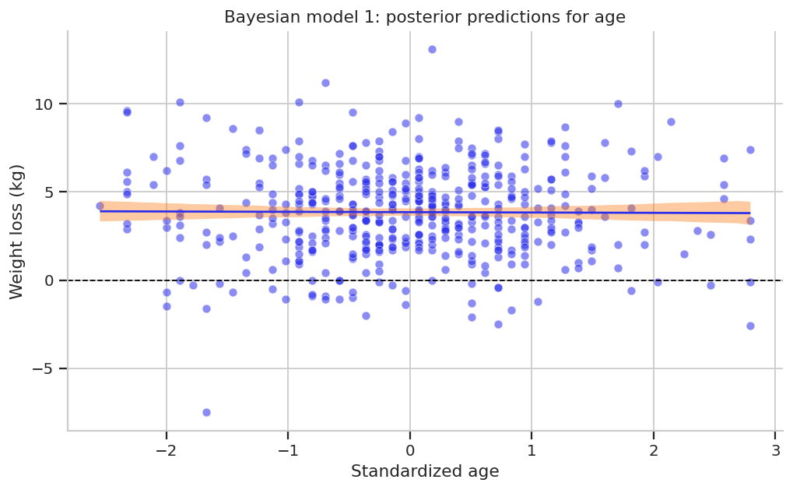
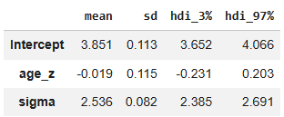
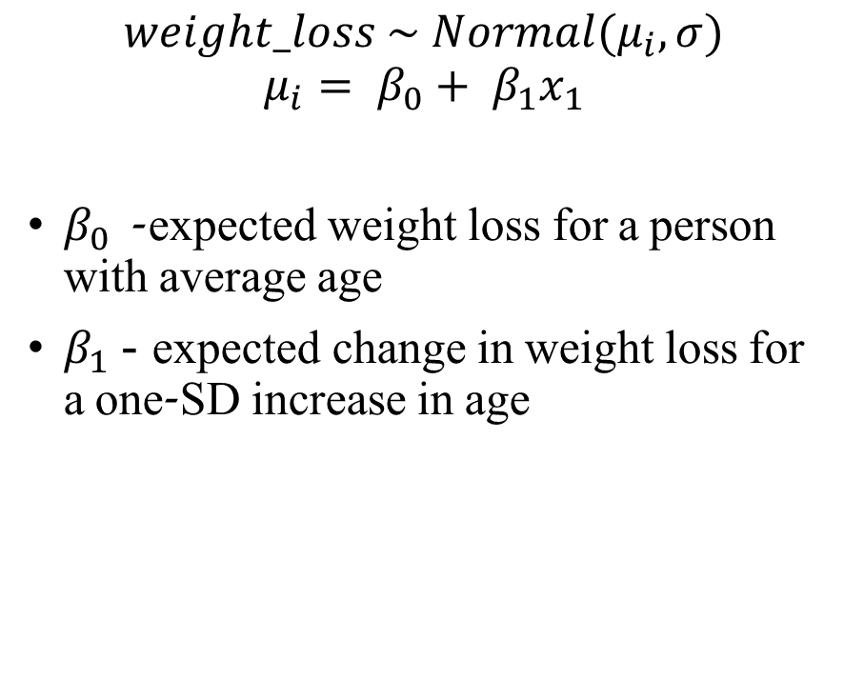

$1^{st}$ Model: weight_loss ~ age_z
$$weight_loss \sim Normal(μ_{i}, σ)$$
$$μ_{i}= β_{0}+ β_{1}x_{1}$$
$β_{0}$- expected weight loss for a person with average age
$β_{1}$ - expected change in weight loss for a one-SD increase in age

Slide 20
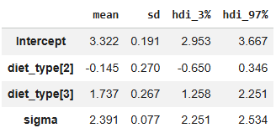
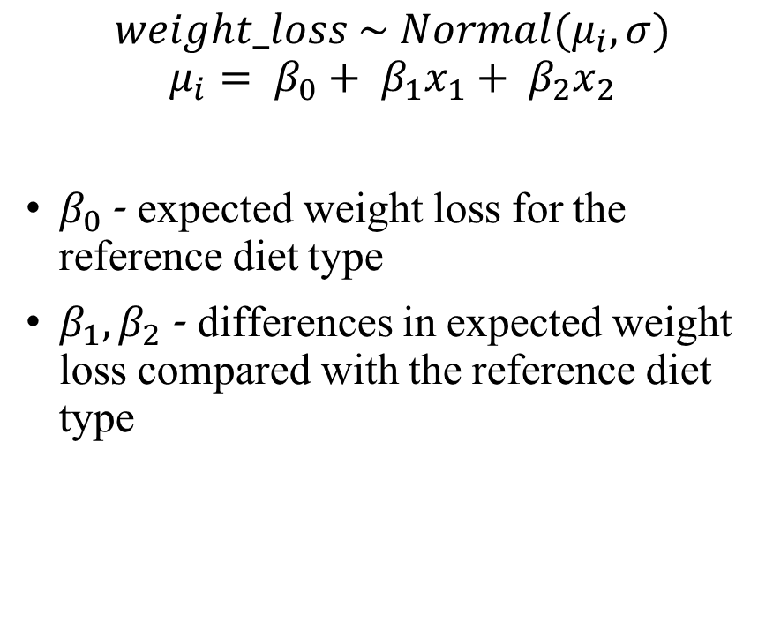
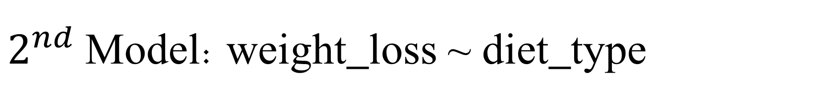
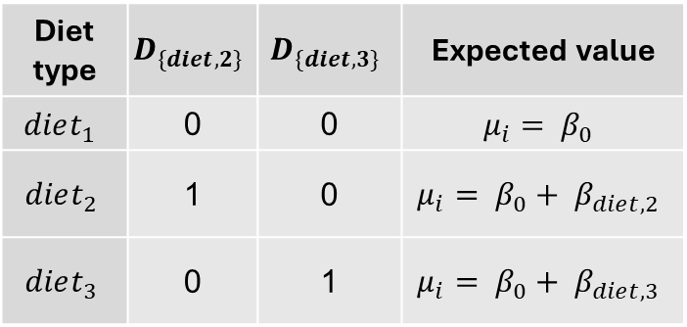
$2^{nd}$ Model: weight_loss ~ diet_type
$$weight_loss \sim Normal(μ_{i}, σ)$$
$$μ_{i}= β_{0}+ β_{1}x_{1}+ β_{2}x_{2}$$
$β_{0}$- expected weight loss for the reference diet type
$β_{1}, β_{2}$ - differences in expected weight loss compared with the reference diet type
Diet type | $$D_{\{diet,2\}}$$ | $$D_{\{diet,3\}}$$ | Expected value
$$diet_{1}$$ | 0 | 0 | $$μ_{i}= β_{0}$$
$$diet_{2}$$ | 1 | 0 | $$μ_{i}= β_{0}+ β_{diet,2}$$
$$diet_{3}$$ | 0 | 1 | $$μ_{i}= β_{0}+ β_{diet,3}$$

Slide 21
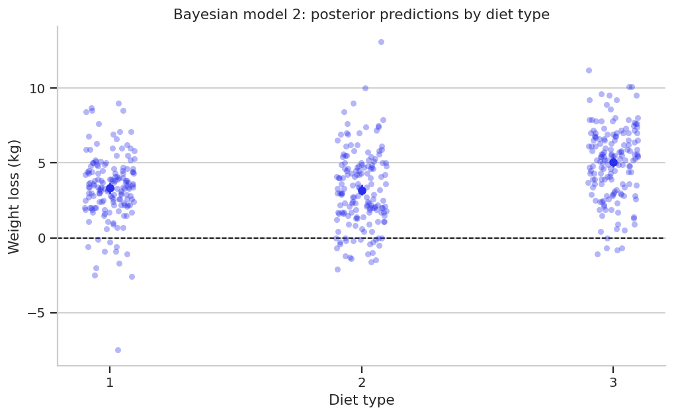
$2^{nd}$ Model: weight_loss ~ diet_type
$$weight_loss \sim Normal(μ_{i}, σ)$$
$$μ_{i}= β_{0}+ β_{1}x_{1}+ β_{2}x_{2}$$
$β_{0}$- expected weight loss for the reference diet type
$β_{1}, β_{2}$ - differences in expected weight loss compared with the reference diet type

Slide 22
Multiple Linear Regression

Slide 23
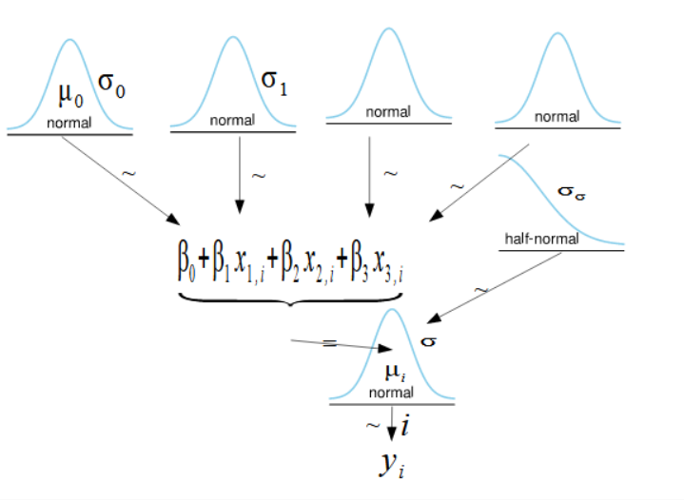






Multiple Regression
Multiple regression includes more than one predictor (independent variable).
For example:
$$σ_{2}$$
$$σ_{3}$$
$$y_{i}\sim N\left(μ_{i}, σ\right)$$
$$μ_{i}=β_{0}+β_{1}x_{1}+β_{2}x_{2}+β_{3}x_{3}$$
$$σ\sim HalfNorm(σ_{σ})$$
$$β_{0}\sim Normal(μ_{0},σ_{0})$$
$$β_{1}\sim Normal\left(μ_{1}, σ_{1}\right)$$
$$β_{2}\sim Normal\left(μ_{2}, σ_{1}\right)$$
$$β_{3}\sim Normal\left(μ_{3}, σ_{1}\right)$$
$$μ_{1}$$
$$μ_{2}$$
$$μ_{3}$$

Slide 24
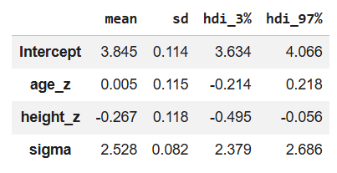
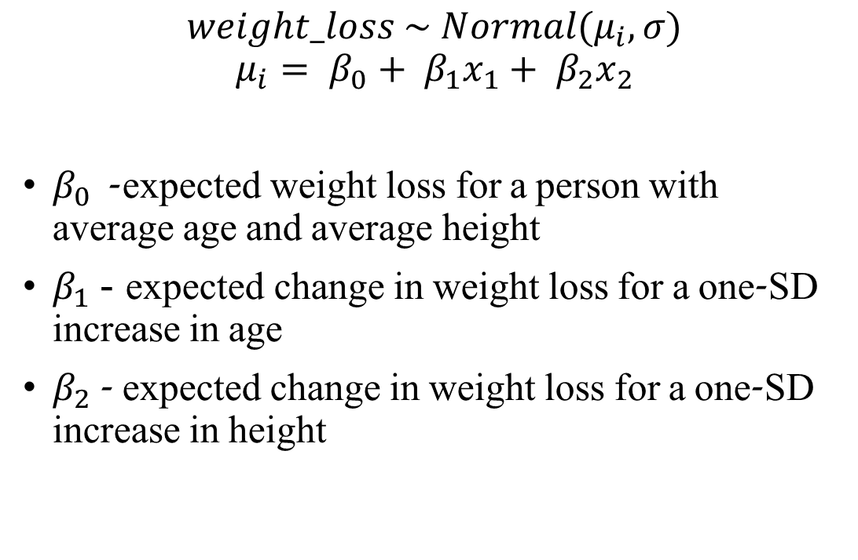
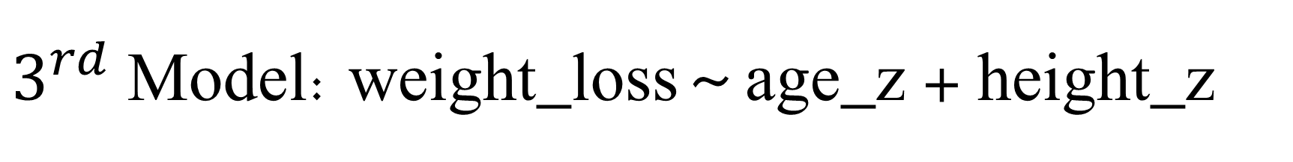
$3^{rd}$ Model: weight_loss ~ age_z + height_z
$$weight_loss \sim Normal(μ_{i}, σ)$$
$$μ_{i}= β_{0}+ β_{1}x_{1}+ β_{2}x_{2}$$
$β_{0}$- expected weight loss for a person with average age and average height
$β_{1}$ - expected change in weight loss for a one-SD increase in age
$β_{2}$ - expected change in weight loss for a one-SD increase in height

Slide 25
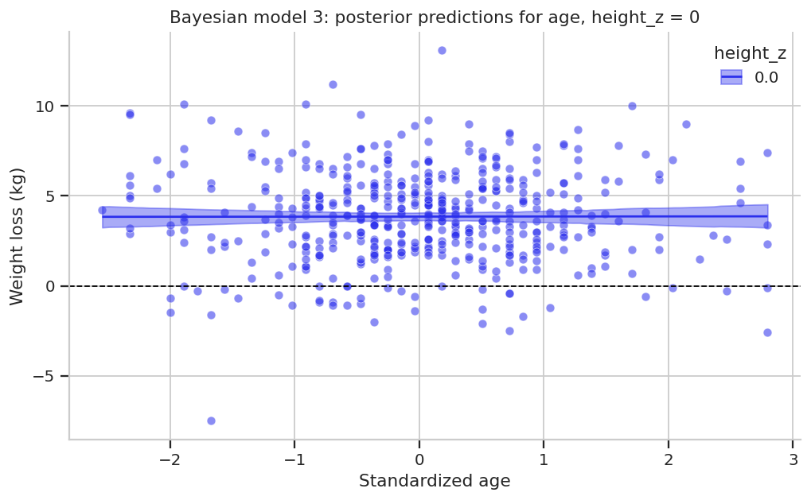
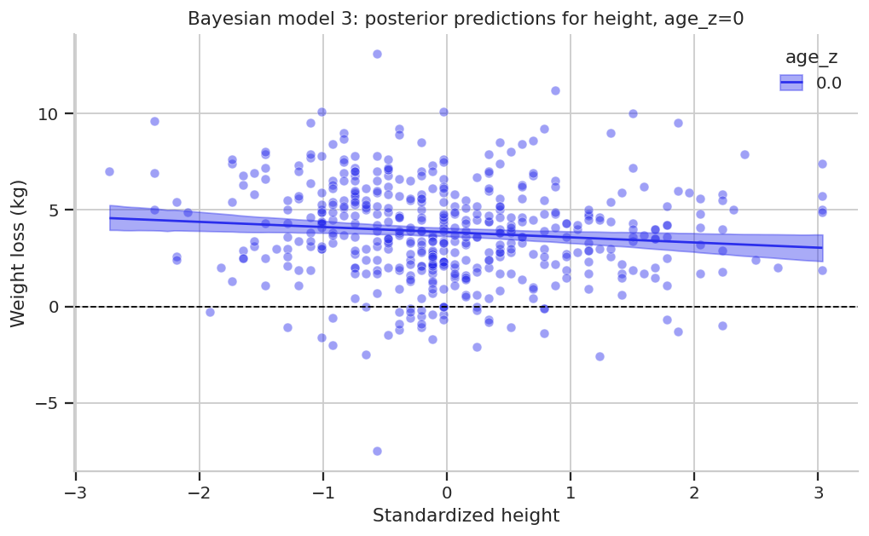
$3^{rd}$ Model: weight_loss ~ age_z + height_z

Slide 26
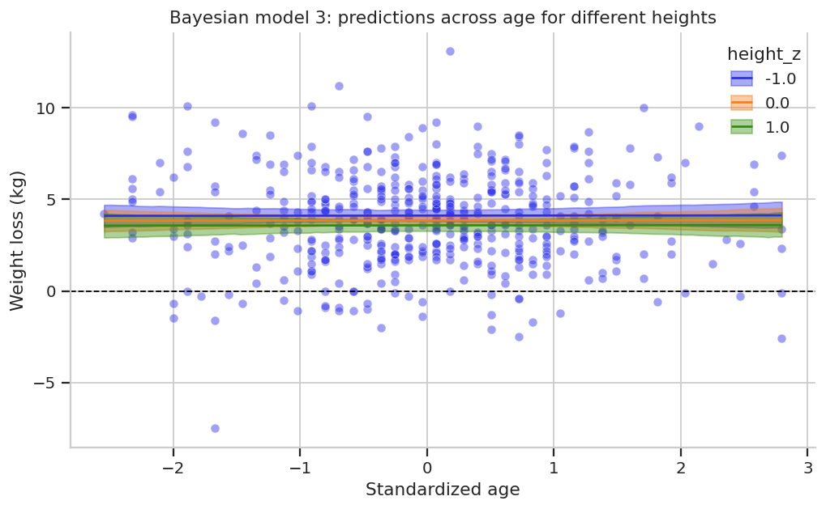
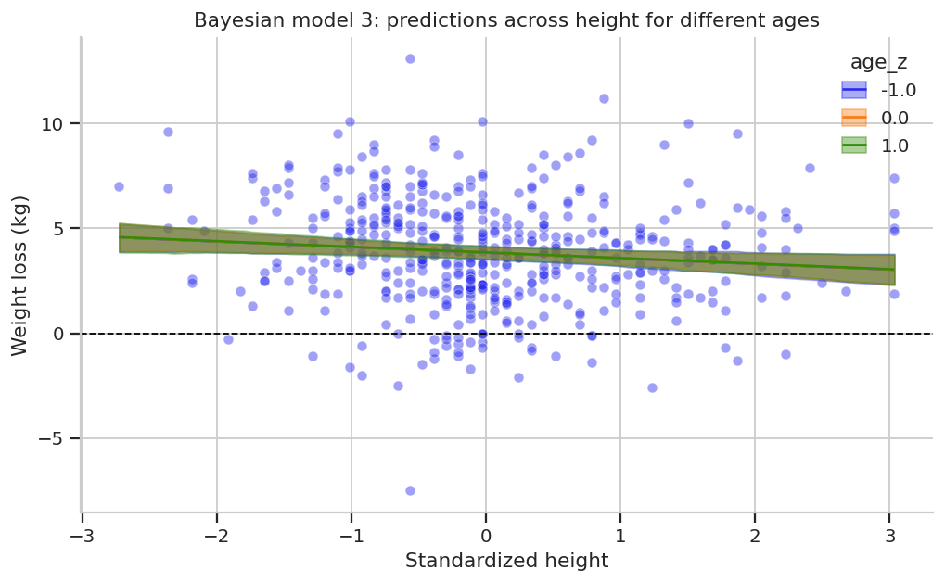
$3^{rd}$ Model: weight_loss ~ age_z + height_z

Slide 27
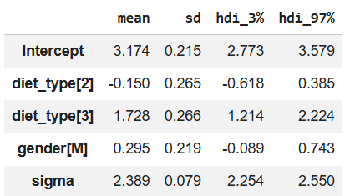
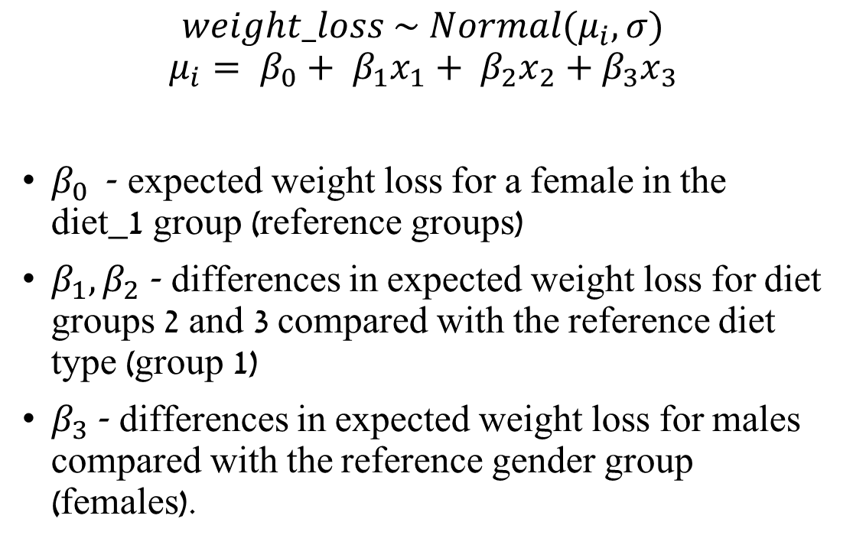
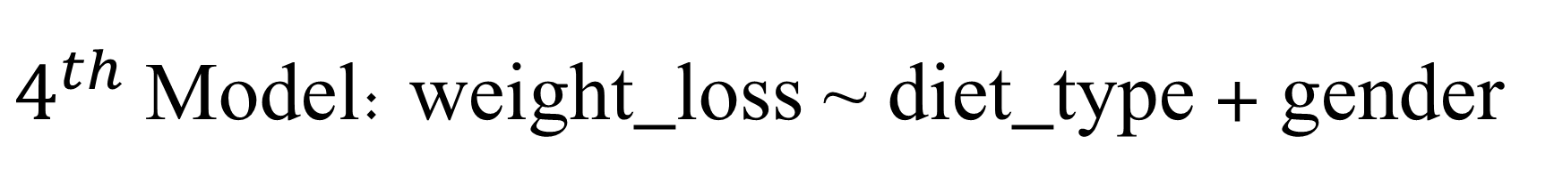
$4^{th}$ Model: weight_loss ~ diet_type + gender
$$weight_loss \sim Normal(μ_{i}, σ)$$
$$μ_{i}= β_{0}+ β_{1}x_{1}+ β_{2}x_{2}+β_{3}x_{3}$$
$β_{0}$- expected weight loss for a female in the diet_1 group (reference groups)
$β_{1}, β_{2}$ - differences in expected weight loss for diet groups 2 and 3 compared with the reference diet type (group 1)
$β_{3}$ - differences in expected weight loss for males compared with the reference gender group (females).

Slide 28
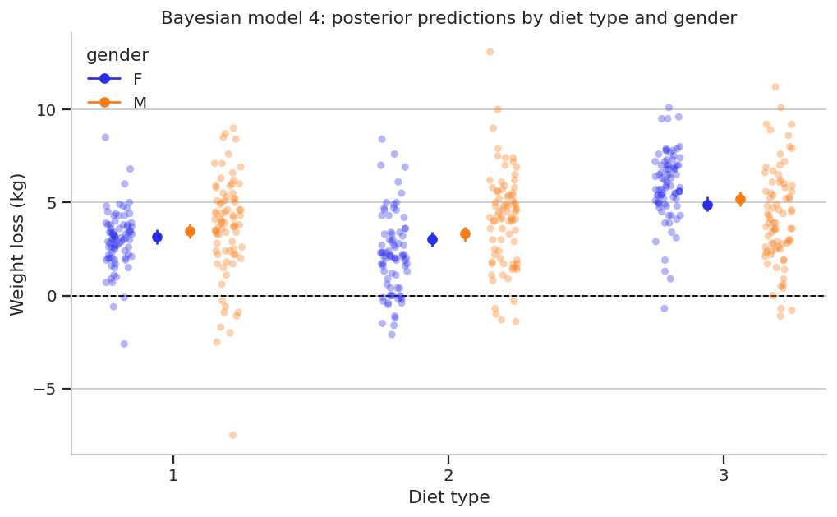
$4^{th}$ Model: weight_loss ~ diet_type + gender

Slide 29
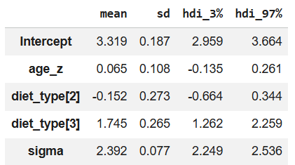
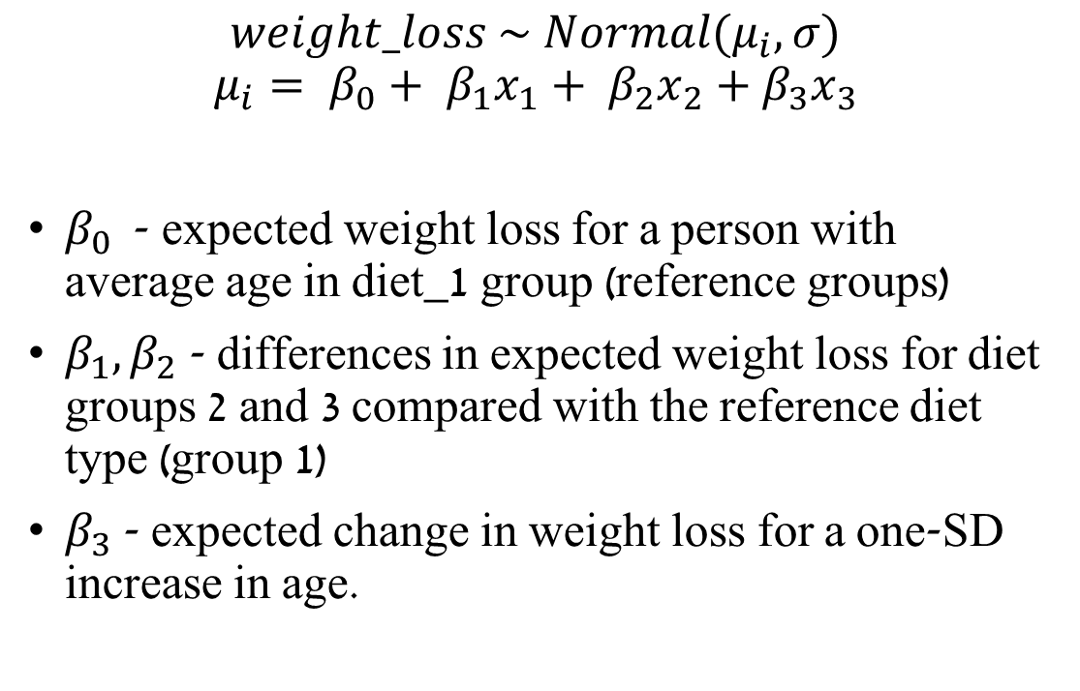

$5^{th}$ Model: weight_loss ~ age_z + diet_type
$$weight_loss \sim Normal(μ_{i}, σ)$$
$$μ_{i}= β_{0}+ β_{1}x_{1}+ β_{2}x_{2}+β_{3}x_{3}$$
$β_{0}$- expected weight loss for a person with average age in diet_1 group (reference groups)
$β_{1}, β_{2}$ - differences in expected weight loss for diet groups 2 and 3 compared with the reference diet type (group 1)
$β_{3}$ - expected change in weight loss for a one-SD increase in age.

Slide 30
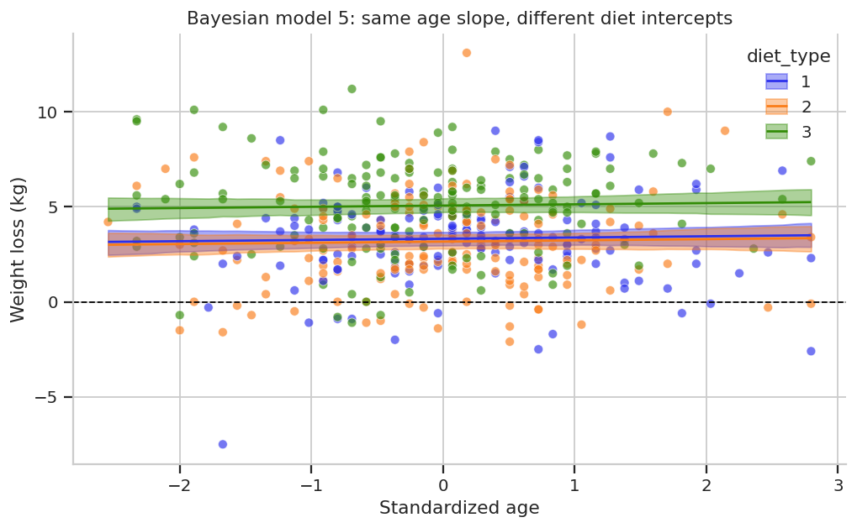
$5^{th}$ Model: weight_loss ~ age_z + diet_type

Slide 31
Interaction Models

Slide 32
Interaction Models
Multiple linear regression with interaction allows for the influence of one predictor to depend on the value of another predictor.
An interaction - the effect of one predictor depends on the value or category of another predictor.

Slide 33
Interaction Models
In a regression model without an interaction, we assume that a predictor has the same effect across all values of the other predictors.
With an interaction, the model allows that effect to change. changes depending on another predictor.
We can use it to tests whether the relationship between one predictor and the outcome.

Slide 34



Interaction Models
An interaction - the effect of one predictor depends on the value or category of another predictor.
$$σ_{2}$$
$$σ_{3}$$
$$μ_{1}$$
$$μ_{2}$$
$$μ_{3}$$
$$y_{i}\sim N\left(μ_{i}, σ\right)$$
$μ_{i}=β_{0}+β_{1}x_{i}$ 𝛽_2 +𝑥_2+𝜷_𝟑 𝒙_𝟏 𝒙_𝟐
$$σ\sim HalfNorm(σ_{σ})$$
$$β_{0}\sim Normal(μ_{0},σ_{0})$$
$$β_{1}\sim Normal\left(μ_{1}, σ_{1}\right)$$
$$β_{2}\sim Normal\left(μ_{2}, σ_{1}\right)$$
$$β_{3}\sim Normal\left(μ_{3}, σ_{1}\right)$$
$$β_{0}+ β_{1}x_{1}+ β_{2}x_{2}+β_{3}x_{1}x_{2}$$

Slide 35
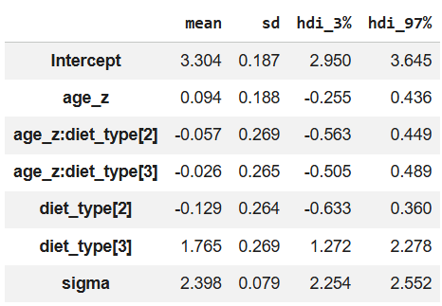
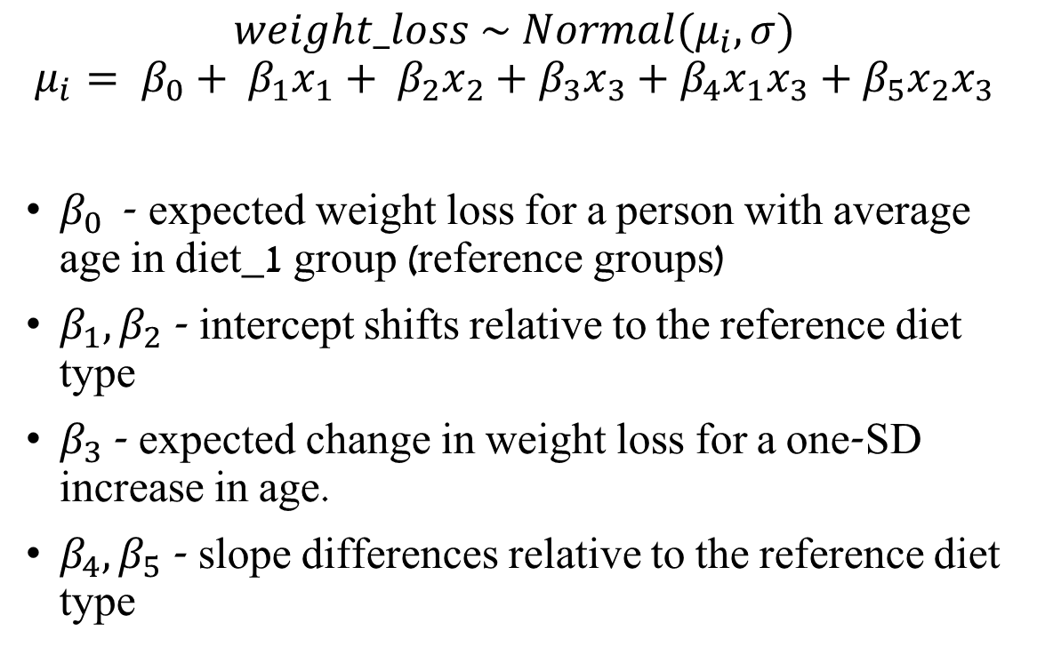

$6^{th}$ Model: weight_loss ~ age_z * diet_type
$$weight_loss \sim Normal(μ_{i}, σ)$$
$$μ_{i}= β_{0}+ β_{1}x_{1}+ β_{2}x_{2}+β_{3}x_{3}+β_{4}x_{1}x_{3}+β_{5}x_{2}x_{3}$$
$β_{0}$- expected weight loss for a person with average age in diet_1 group (reference groups)
$β_{1}, β_{2}$ - intercept shifts relative to the reference diet type
$β_{3}$ - expected change in weight loss for a one-SD increase in age.
$β_{4}, β_{5}$ - slope differences relative to the reference diet type

Slide 36
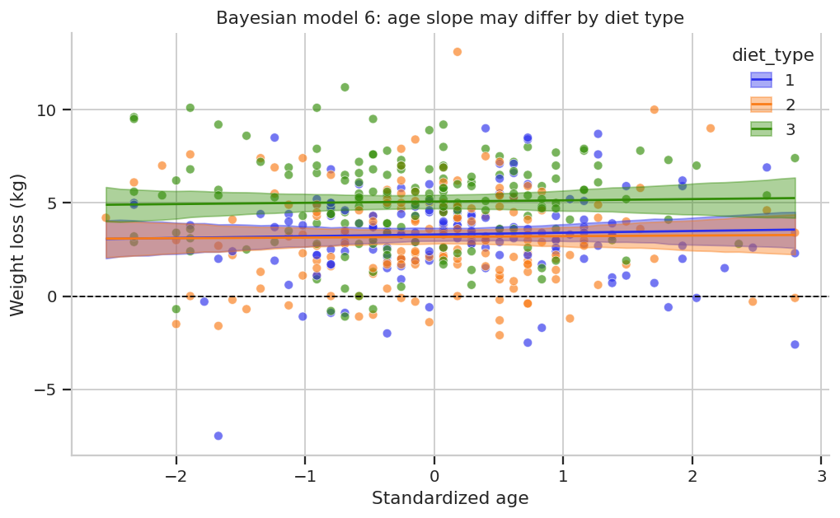
$6^{th}$ Model: weight_loss ~ age_z * diet_type

Slide 37
With and Without Interaction
Without Interaction With Interaction
The interaction model allows the age slope to differ by diet type
Notes:
Note the slope change in diet_type 2

Slide 38
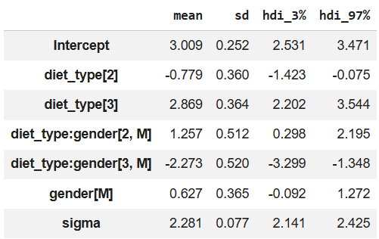
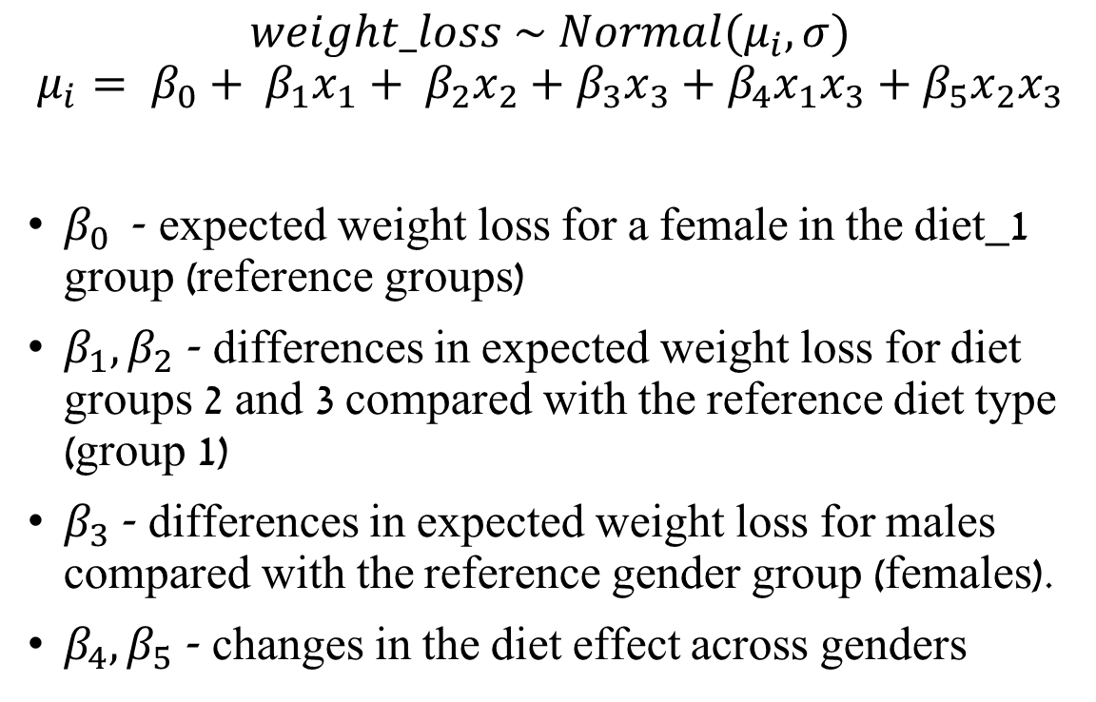
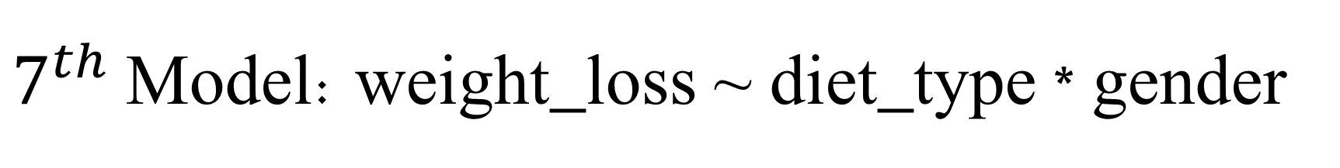
$7^{th}$ Model: weight_loss ~ diet_type * gender
$$weight_loss \sim Normal(μ_{i}, σ)$$
$$μ_{i}= β_{0}+ β_{1}x_{1}+ β_{2}x_{2}+β_{3}x_{3}+β_{4}x_{1}x_{3}+β_{5}x_{2}x_{3}$$
$β_{0}$- expected weight loss for a female in the diet_1 group (reference groups)
$β_{1}, β_{2}$ - differences in expected weight loss for diet groups 2 and 3 compared with the reference diet type (group 1)
$β_{3}$ - differences in expected weight loss for males compared with the reference gender group (females).
$β_{4}, β_{5}$ - changes in the diet effect across genders

Slide 39

$7^{th}$ Model: weight_loss ~ diet_type * gender

Slide 40
With and Without Interaction
Without Interaction With Interaction
The interaction model allows the diet effect to differ by gender
Notes:
The interaction model allows the diet effect to differ by gender

Slide 41
Today’s Models
Model Type |  | Wilkinson Notation | Interpretation
Simple linear | one continuous predictor | weight_loss ~ age_z | One slope: weight loss changes linearly with age
 | one categorical predictor | weight_loss ~ diet_type | Mean differences between diet types
Multiple linear | continuous + continuous predictors | weight_loss ~ age_z + height_z | Adjusted slopes: each predictor is interpreted while holding the other fixed
 | categorical + categorical predictors | weight_loss ~ diet_type + gender | Additive group effects: diet and gender contribute separately
 | continuous + categorical predictors | weight_loss ~ age_z + diet_type | Same age slope for all diet types, different intercepts by diet
Interaction | continuous * categorical | weight_loss ~ age_z * diet_type | The age slope may differ between diet types
 | categorical * categorical | weight_loss ~ diet_type * gender | The diet effect is allowed to differ by gender
Notes:
Green - Simple linear regression
Blue - Multiple linear regression
Purple - Multiple linear regression with interaction
$$weight_loss \sim diet_type ∗ gender$$
Is the same as in Bambi
$$weight_loss \sim diet_type + gender + diet_type:gender$$

Slide 42
Bayesian Effect Size Measures
These measures summarize explained variation or effect size.
They should not be used alone to choose the best model.

Slide 43
Effect Size Measures
In the Bayesian framework, effect sizes are calculated for every posterior draw using μ and σ.
Therefore, Bayesian effect sizes are posterior distributions.
In this tutorial, posterior predictive draws are used for model checking, not for effect-size calculation.

Slide 44
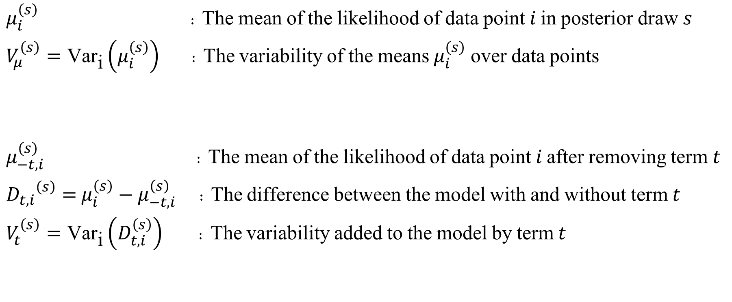
Effect Size Measures - Definitions
$μ_{i}^{\left(s\right)}$ : The mean of the likelihood of data point $i$ in posterior draw $s$
$V_{μ}^{\left(s\right)}=\text{Va}{\text{r}}_{\text{i}}\left(μ_{i}^{\left(s\right)}\right)$ : The variability of the means $μ_{i}^{\left(s\right)}$ over data points
$μ_{−t, i}^{\left(s\right)}$ : The mean of the likelihood of data point $i$ after removing term $t$
${D_{t,i}}^{\left(s\right)}=$ $μ_{i}^{\left(s\right)}−$ $μ_{−t, i}^{\left(s\right)}$ : The difference between the model with and without term $t$
$V_{t}^{\left(s\right)}=\text{Va}{\text{r}}_{\text{i}}\left(D_{t,i}^{\left(s\right)}\right)$ : The variability added to the model by term $t$
Notes:
The difference between ${R^{2}}_{\text{partial},t}^{\left(s\right)}$ and ${η^{2}}^{\left(s\right)}$ is in the denominator:
$R_{partial}^{2}$ takes variability explained by term $t$ out of variability not explained by other terms
$η^{2}$ takes explained by term $t$ out of total variability in the data
הממוצע של הלייקליהוד של הדאטה בנקודה מסויימת בדגימה פוסטריורית מסויימת
השונות של הממוצעים על הדאטה, בכל הדגימות

Slide 45
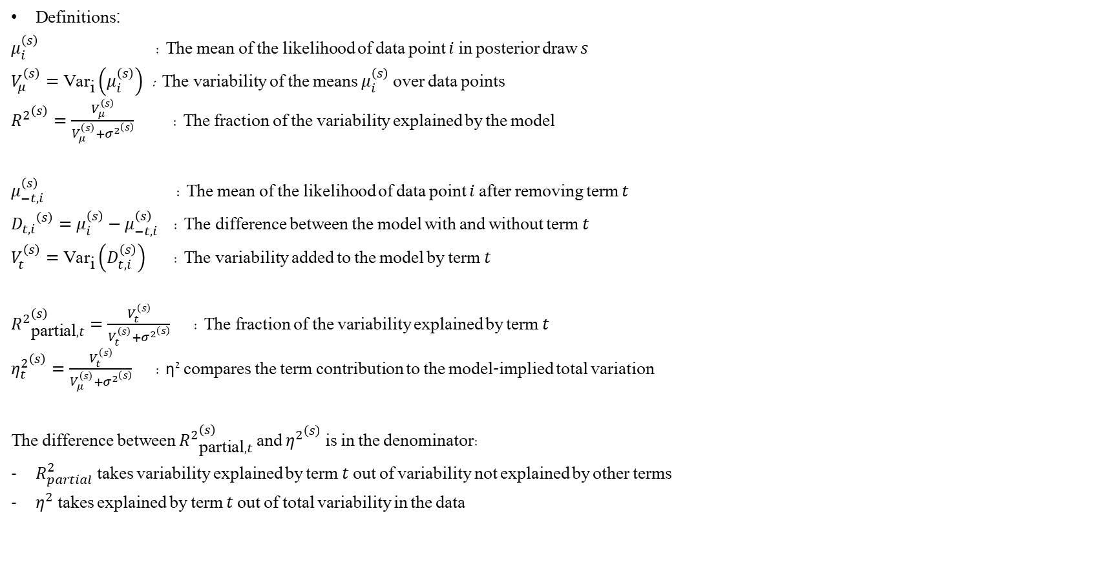
Effect Size Measures
Definitions :
$μ_{i}^{\left(s\right)}$ : The mean of the likelihood of data point $i$ in posterior draw $s$
$V_{μ}^{\left(s\right)}=\text{Va}{\text{r}}_{\text{i}}\left(μ_{i}^{\left(s\right)}\right)$ : The variability of the means $μ_{i}^{\left(s\right)}$ over data points
${R^{2}}^{\left(s\right)}=\frac{V_{μ}^{\left(s\right)}}{V_{μ}^{\left(s\right)}+{σ^{2}}^{\left(s\right)}}$ : The fraction of the variability explained by the model
$μ_{−t, i}^{\left(s\right)}$ : The mean of the likelihood of data point $i$ after removing term $t$
${D_{t,i}}^{\left(s\right)}=$ $μ_{i}^{\left(s\right)}−$ $μ_{−t, i}^{\left(s\right)}$ : The difference between the model with and without term $t$
$V_{t}^{\left(s\right)}=\text{Va}{\text{r}}_{\text{i}}\left(D_{t,i}^{\left(s\right)}\right)$ : The variability added to the model by term $t$
${R^{2}}_{\text{partial},t}^{\left(s\right)}=\frac{V_{t}^{\left(s\right)}}{V_{t}^{\left(s\right)}+{σ^{2}}^{\left(s\right)}}$ : The fraction of the variability explained by term $t$
${η_{t}^{2}}^{\left(s\right)}=\frac{V_{t}^{\left(s\right)}}{V_{μ}^{\left(s\right)}+{σ^{2}}^{\left(s\right)}}$ : η² compares the term contribution to the model-implied total variation
The difference between ${R^{2}}_{\text{partial},t}^{\left(s\right)}$ and ${η^{2}}^{\left(s\right)}$ is in the denominator:
$R_{partial}^{2}$ takes variability explained by term $t$ out of variability not explained by other terms
$η^{2}$ takes explained by term $t$ out of total variability in the data
Notes:
The difference between ${R^{2}}_{\text{partial},t}^{\left(s\right)}$ and ${η^{2}}^{\left(s\right)}$ is in the denominator:
$R_{partial}^{2}$ takes variability explained by term $t$ out of variability not explained by other terms
$η^{2}$ takes explained by term $t$ out of total variability in the data

Slide 46
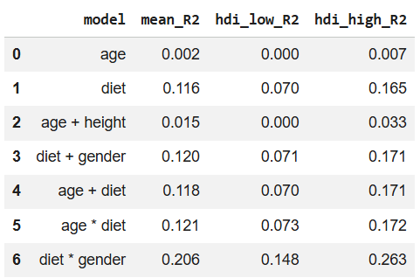
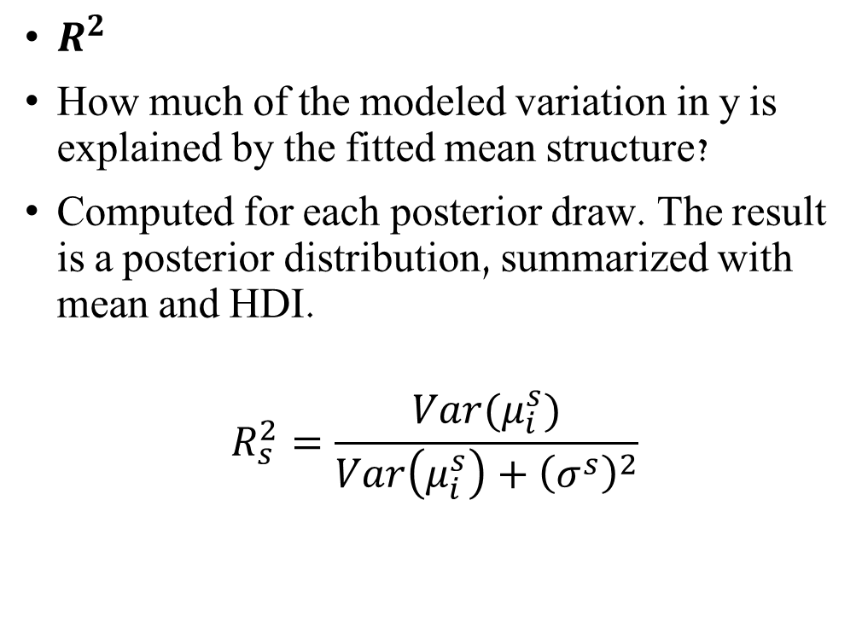
Effect Size Measures
$R^{2}$
How much of the modeled variation in y is explained by the fitted mean structure?
Computed for each posterior draw. The result is a posterior distribution, summarized with mean and HDI.
$$R_{s}^{2}=\frac{Var(μ_{i}^{s})}{Var\left(μ_{i}^{s}\right)+{\left(σ^{s}\right)}^{2}}$$

Slide 47
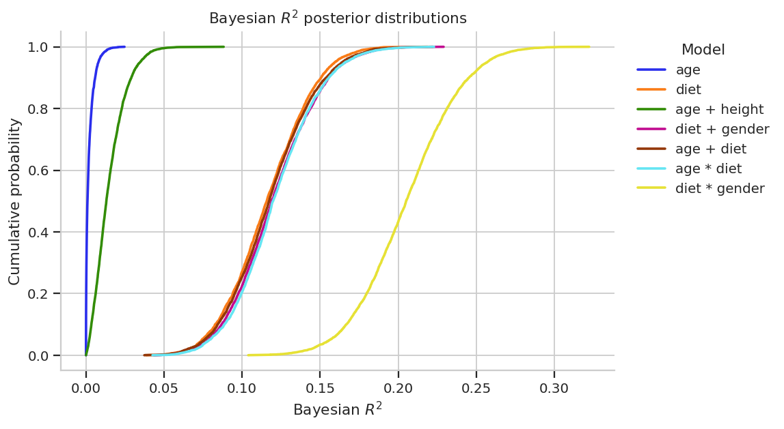
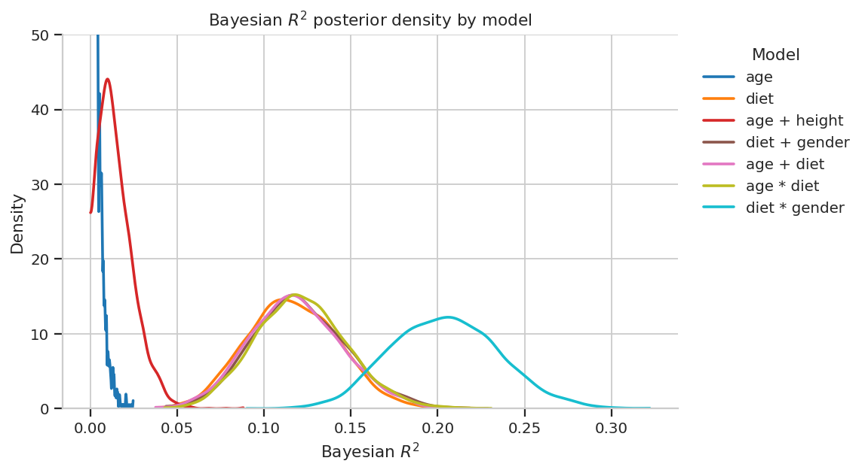
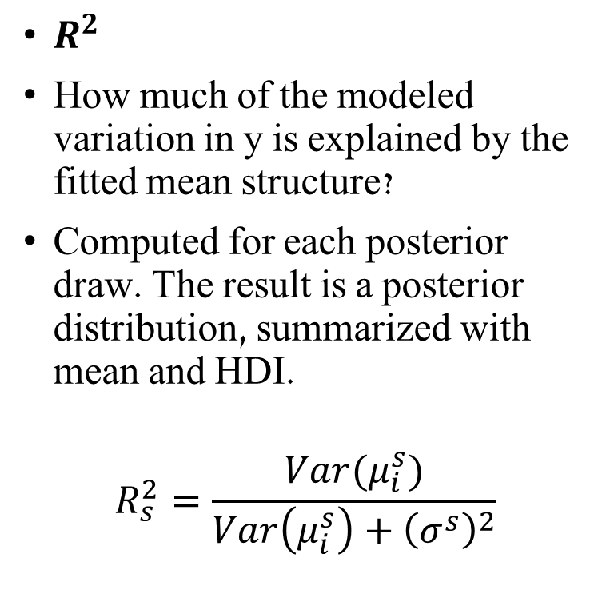
Effect Size Measures
$R^{2}$
How much of the modeled variation in y is explained by the fitted mean structure?
Computed for each posterior draw. The result is a posterior distribution, summarized with mean and HDI.
$$R_{s}^{2}=\frac{Var(μ_{i}^{s})}{Var\left(μ_{i}^{s}\right)+{\left(σ^{s}\right)}^{2}}$$

Slide 48

Effect Size Measures
Bayesian term-level partial $R^{2}$
How large is a specific term relative to that term plus residual variation?
Term-level Bayesian effect size for terms such as diet_type, gender, age_z:diet_type, diet_type:gender
Computed from posterior draws of μ and σ
$${R^{2}}_{\text{partial},t}^{\left(s\right)}=\frac{V_{t}^{\left(s\right)}}{V_{t}^{\left(s\right)}+{σ^{2}}^{\left(s\right)}}$$

Slide 49

Effect Size Measures
Bayesian $η^{2}$
η² compares the term contribution to the model-implied total variation
$${η_{t}^{2}}^{\left(s\right)}=\frac{V_{t}^{\left(s\right)}}{V_{μ}^{\left(s\right)}+{σ^{2}}^{\left(s\right)}}$$
The difference between ${R^{2}}_{\text{partial},t}^{\left(s\right)}$ and ${η^{2}}^{\left(s\right)}$ is in the denominator:
$R_{partial}^{2}$ takes variability explained by term $t$ out of variability not explained by other terms
$η^{2}$ takes explained by term $t$ out of total variability in the data

Slide 50

Effect Size Measures
$Bayesian Cohen^{′}s f$
How large is the term’s explained variation relative to residual variation?
Standardized effect-size scale
Larger f means the term is large relative to unexplained variation.
$$Cohen’s f =\frac{\sqrt{V_{t}^{\left(s\right)}}}{\sqrt{{σ^{2}}^{\left(s\right)}}}$$

Slide 51

Effect Size Measures Summary Table
Measure | Formula | What it asks
Bayesian $R^{2}$ | $$R_{s}^{2}=\frac{Var(μ_{i}^{s})}{Var\left(μ_{i}^{s}\right)+{\left(σ^{s}\right)}^{2}}$$ | How much of the modeled variation in y is explained by the fitted mean structure?
Bayesian term-level partial $R^{2}$ | $${R^{2}}_{\text{partial},t}^{\left(s\right)}=\frac{V_{t}^{\left(s\right)}}{V_{t}^{\left(s\right)}+{σ^{2}}^{\left(s\right)}}$$ | How large is a specific term relative to that term plus residual variation?
Bayesian $η^{2}$ | $${η_{t}^{2}}^{\left(s\right)}=\frac{V_{t}^{\left(s\right)}}{V_{μ}^{\left(s\right)}+{σ^{2}}^{\left(s\right)}}$$ | $$\text{What} \text{fraction} \text{of} \text{model}\text{−}\text{implied} \text{total} \text{variation} \text{is} \text{associated} \text{with} \text{term}\text{?}$$
Bayesian Cohen’s f | $$Cohen’s f =\frac{\sqrt{V_{t}^{\left(s\right)}}}{\sqrt{{σ^{2}}^{\left(s\right)}}}$$ | How large is the term’s contribution relative to residual variation?

Slide 52
Effect Size Measures
Bayesian partial R², η², and Cohen’s f for each model
 | model | term | mean_eta_sq | hdi_low_eta_sq | hdi_high_eta_sq | mean_partial_R2_term | hdi_low_partial_R2_term | hdi_high_partial_R2_term | mean_cohens_f | hdi_low_cohens_f | hdi_high_cohens_f
0 | age | age_z | 0.002 | 0.000 | 0.007 | 0.002 | 0.000 | 0.007 | 0.037 | 0.000 | 0.086
1 | diet | diet_type | 0.116 | 0.070 | 0.165 | 0.116 | 0.070 | 0.165 | 0.361 | 0.274 | 0.445
2 | age + height | age_z | 0.002 | 0.000 | 0.007 | 0.002 | 0.000 | 0.007 | 0.036 | 0.000 | 0.086
3 | age + height | height_z | 0.013 | 0.000 | 0.031 | 0.013 | 0.000 | 0.031 | 0.106 | 0.020 | 0.193
4 | diet + gender | diet_type | 0.115 | 0.067 | 0.166 | 0.116 | 0.067 | 0.167 | 0.360 | 0.269 | 0.449
5 | diet + gender | gender | 0.005 | 0.000 | 0.016 | 0.006 | 0.000 | 0.018 | 0.065 | 0.000 | 0.135
6 | age + diet | age_z | 0.002 | 0.000 | 0.008 | 0.003 | 0.000 | 0.009 | 0.042 | 0.000 | 0.098
7 | age + diet | diet_type | 0.118 | 0.069 | 0.171 | 0.118 | 0.069 | 0.170 | 0.363 | 0.278 | 0.459
8 | age * diet | age_z | 0.007 | 0.000 | 0.023 | 0.007 | 0.000 | 0.025 | 0.070 | 0.000 | 0.162
9 | age * diet | diet_type | 0.117 | 0.070 | 0.170 | 0.118 | 0.070 | 0.169 | 0.364 | 0.278 | 0.456
10 | age * diet | age_z:diet_type | 0.007 | 0.000 | 0.022 | 0.008 | 0.000 | 0.025 | 0.081 | 0.007 | 0.162
11 | diet * gender | diet_type | 0.382 | 0.273 | 0.495 | 0.323 | 0.244 | 0.402 | 0.692 | 0.567 | 0.819
12 | diet * gender | gender | 0.020 | 0.000 | 0.053 | 0.024 | 0.000 | 0.063 | 0.141 | 0.001 | 0.260
13 | diet * gender | diet_type:gender | 0.177 | 0.093 | 0.267 | 0.181 | 0.096 | 0.255 | 0.469 | 0.337 | 0.596

Slide 53
Frequentist Regression
In-depth explanations in the tutorial code notebook
Notes:
Bayesian analysis focuses on uncertainty about parameters and predictive checks.
Frequentist analysis focuses on point estimates, sampling-based uncertainty, and sums-of-squares summaries.
Both can use the same model structure, but they answer the question in different languages.

Slide 54

Frequentist Regression
Calculating $\hat{y}$ directly from the data
The regression formula is
$$\hat{y}= b_{0}+ b_{1}x_{1}+ b_{2}x_{2}+…+b_{n}x_{n}$$
Instead of
$$y \sim Normal(μ_{i},σ)$$
$μ_{i}= β_{0}+ β_{1}x_{1}+ β_{2}x_{2}+…+β_{n}x_{n}$
The Effect sizes are calculated directly on the data instead of the posterior draws.
Notes:
Bayesian analysis focuses on uncertainty about parameters and predictive checks.
Frequentist analysis focuses on point estimates, sampling-based uncertainty, and sums-of-squares summaries.
Both can use the same model structure, but they answer the question in different languages.

Slide 55

Frequentist Regression
Example for interaction model with OLS:
$$\hat{y}= b_{0}+ b_{1}x_{1}+ b_{2}x_{2}+b_{3}x_{3}+b_{4}x_{1}x_{3}+b_{5}x_{2}x_{3}$$
$b_{0}$- expected weight loss for a person with average age in diet_1 group (reference groups)
$b_{1}, b_{2}$ - intercept shifts relative to the reference diet type
$b_{3}$ - expected change in weight loss for a one-SD increase in age.
$b_{4}, b_{5}$ - slope differences relative to the reference diet type
Notes:
Bayesian analysis focuses on uncertainty about parameters and predictive checks.
Frequentist analysis focuses on point estimates, sampling-based uncertainty, and sums-of-squares summaries.
Both can use the same model structure, but they answer the question in different languages.

Slide 56

Frequentist Regression
Example for interaction model with OLS:
In both Bambi and smf.ols formula notation:
weight_loss ~ age_z*diet_type
is the same as
weight_loss ~ age_z + diet_type + age_z:diet_type
Notes:
Bayesian analysis focuses on uncertainty about parameters and predictive checks.
Frequentist analysis focuses on point estimates, sampling-based uncertainty, and sums-of-squares summaries.
Both can use the same model structure, but they answer the question in different languages.

Slide 57
Frequentist Regression
Notes:
Bayesian analysis focuses on uncertainty about parameters and predictive checks.
Frequentist analysis focuses on point estimates, sampling-based uncertainty, and sums-of-squares summaries.
Both can use the same model structure, but they answer the question in different languages.

Slide 58

Frequentist Regression
Notes:
Bayesian analysis focuses on uncertainty about parameters and predictive checks.
Frequentist analysis focuses on point estimates, sampling-based uncertainty, and sums-of-squares summaries.
Both can use the same model structure, but they answer the question in different languages.

Slide 59

Frequentist Regression
Notes:
Bayesian analysis focuses on uncertainty about parameters and predictive checks.
Frequentist analysis focuses on point estimates, sampling-based uncertainty, and sums-of-squares summaries.
Both can use the same model structure, but they answer the question in different languages.

Slide 60

Frequentist vs Bayesian Regression
Topic | Bayesian approach | Frequentist approach
Model formula | Uses the same formula notation | Uses the same formula notation
Coefficients | Unknown quantities with posterior distributions ($β$) | Fixed but unknown quantities estimated by point estimates (b)
Uncertainty | Summarized by posterior distributions and HDI intervals | Summarized by standard errors, confidence intervals, and p-values
Model fitting | Bambi samples from the posterior distribution | OLS finds coefficient estimates that minimize squared residuals
Model checking | Prior predictive checks, diagnostics, posterior predictive checks | Residual-based checks and ANOVA-style summaries
Prediction plots | Show posterior predictions of the expected mean structure | Show fitted OLS prediction lines or group means
Explained variance | The effect sizes are distributions | The effect sizes are point summaries
Notes:
Bayesian analysis focuses on uncertainty about parameters and predictive checks.
Frequentist analysis focuses on point estimates, sampling-based uncertainty, and sums-of-squares summaries.
Both can use the same model structure, but they answer the question in different languages.

Slide 61
Frequentist Effect Size Measures
These measures summarize explained variation or effect size.
They should not be used alone to choose the best model.

Slide 62
Effect Size Measures
In the Bayesian framework, effect sizes are calculated for every posterior draw using μ and σ.
In the frequentist framework, effect sizes are calculated from one fitted OLS model using sums of squares.
The result is one point summary for each model or term.
Notes:
Definitions
$$SS_{res}=\sum_{i}{(}\left.y_{i}−{\hat{y}}_{i}{\left.)\right.}^{2}\right.$$
$$SS_{reg}=\sum_{i}{(}\left.{\hat{y}}_{i}−\overset{ˉ}{y}{\left.)\right.}^{2}\right.$$
$$SS_{tot}=\sum_{i}{(}\left.y_{i}−\overset{ˉ}{y}{\left.)\right.}^{2}=SS_{reg}+SS_{res}\right.$$
$$RSS=SS_{res}$$
Where:
SStot = total variation in the observed outcome SSreg = variation explained by the fitted model SSres / RSS = residual unexplained variation SSterm = variation attributed to one model term n = number of observations p = number of predictors, not including the intercept

Slide 63

Effect Size Measures
Definitions :
$$SS_{res}=RSS=\sum_{i}{(}\left.y_{i}−{\hat{y}}_{i}{\left.)\right.}^{2}\right.$$
$$SS_{reg}=\sum_{i}{(}\left.{\hat{y}}_{i}−\overset{ˉ}{y}{\left.)\right.}^{2}\right.$$
$$SS_{tot}=\sum_{i}{(}\left.y_{i}−\overset{ˉ}{y}{\left.)\right.}^{2}=SS_{reg}+SS_{res}\right.$$
Where:
$SS_{tot}$= total variation in the observed outcome
$SS_{reg}$ = variation explained by the fitted model
$SS_{res}$ / $RSS$ = residual unexplained variation
$SS_{term}$ = variation attributed to one model term
Notes:
Definitions
$$SS_{res}=\sum_{i}{(}\left.y_{i}−{\hat{y}}_{i}{\left.)\right.}^{2}\right.$$
$$SS_{reg}=\sum_{i}{(}\left.{\hat{y}}_{i}−\overset{ˉ}{y}{\left.)\right.}^{2}\right.$$
$$SS_{tot}=\sum_{i}{(}\left.y_{i}−\overset{ˉ}{y}{\left.)\right.}^{2}=SS_{reg}+SS_{res}\right.$$
$$RSS=SS_{res}$$
Where:
SStot = total variation in the observed outcome SSreg = variation explained by the fitted model SSres / RSS = residual unexplained variation SSterm = variation attributed to one model term n = number of observations p = number of predictors, not including the intercept

Slide 64

Effect Size Measures - Frequentist
Measure | $$Formula$$ | What it asks
$$R^{2}$$ | $$R^{2}=\frac{SS_{reg}}{SS_{tot}}=1 −\frac{SS_{res}}{SS_{tot}}$$ | How much of the total variation in (y) is explained by the whole model?
$$Term −level \\ partial R^{2}$$ | $$\frac{SS_{term}}{SS_{term}+SS_{res}}$$ | How large is a specific ANOVA term relative to that term plus residual variation?
$$η^{2}$$ | $$η^{2}=\frac{SS_{term}}{SS_{tot}}$$ | What proportion of total variation is associated with a specific term?
$$Cohen’s f$$ | $$Cohen’s f =\frac{\sqrt{SS_{term}}}{\sqrt{SS_{res}}}$$ | How large is the term’s explained variation relative to residual variation?
Notes:
Definitions :
$$SS_{res}=\sum_{i}{(}\left.y_{i}−{\hat{y}}_{i}{\left.)\right.}^{2}\right.$$
$$SS_{reg}=\sum_{i}{(}\left.{\hat{y}}_{i}−\overset{ˉ}{y}{\left.)\right.}^{2}\right.$$
$$SS_{tot}=\sum_{i}{(}\left.y_{i}−\overset{ˉ}{y}{\left.)\right.}^{2}=SS_{reg}+SS_{res}\right.$$
$$RSS=SS_{res}$$
Where:
SStot = total variation in the observed outcome SSreg = variation explained by the fitted model SSres / RSS = residual unexplained variation SSterm = variation attributed to one model term n = number of observations p = number of predictors, not including the intercept

Slide 65

ANOVA Style Summary Tables
In this tutorial, we use ANOVA-style summaries to quantify how much variation is associated with model terms.
For example:
We are not treating ANOVA as a standalone frequentist hypothesis test just yet.
Notes:
Frequentist statistics

Slide 66


ANOVA style Summary Tables
Notes:
Frequentist statistics

